Slide 1
Data SCIENCE Part I: Course intro & Python tutorial
Dr. Dang Thien Binh
IT Faculty, Da Nang University of Science and Technology

Slide 2
Contact
Instructor: Dr. Dang Thien Binh
dtbinh@udn.edu.vn, binh01t2@gmail.com
Mobile: 0935556678

Slide 3
Plan for this lecture
Course information
Data Science - why all the excitement
What is data science
Basic Python programming

Slide 4
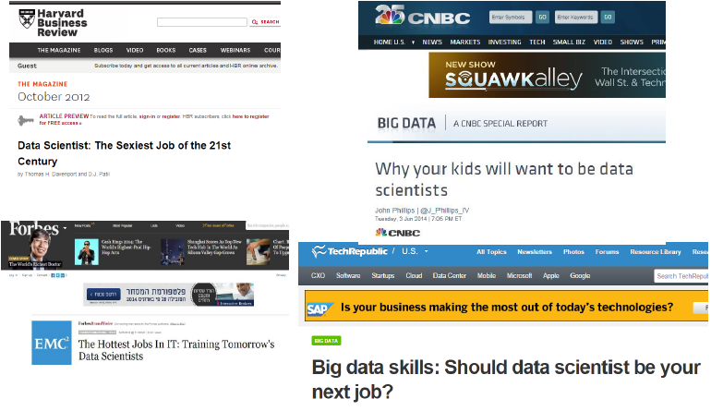
Data Scientists are in high demand

Slide 5
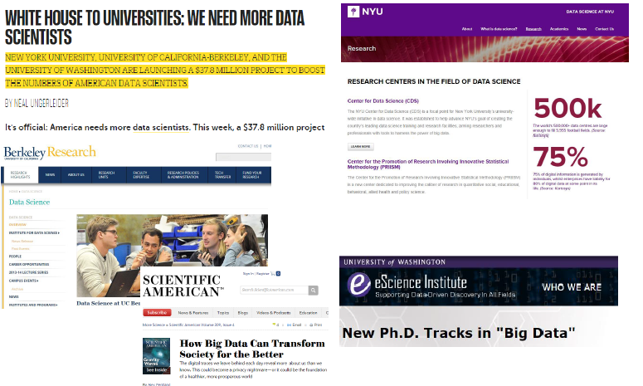
Also in academia

Slide 6
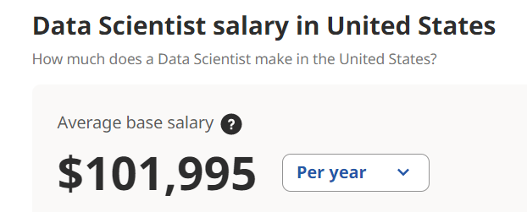
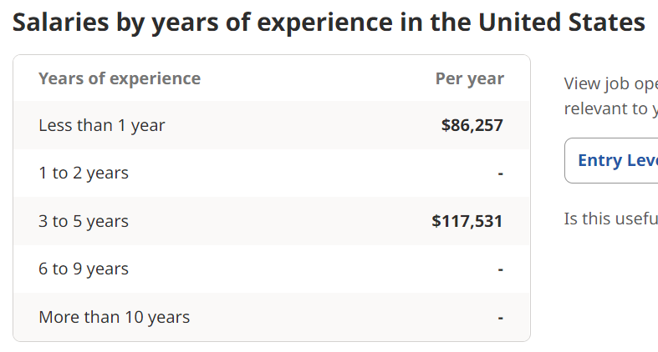
Pays Well
https://www.indeed.com/career/data-scientist/salaries

Slide 7
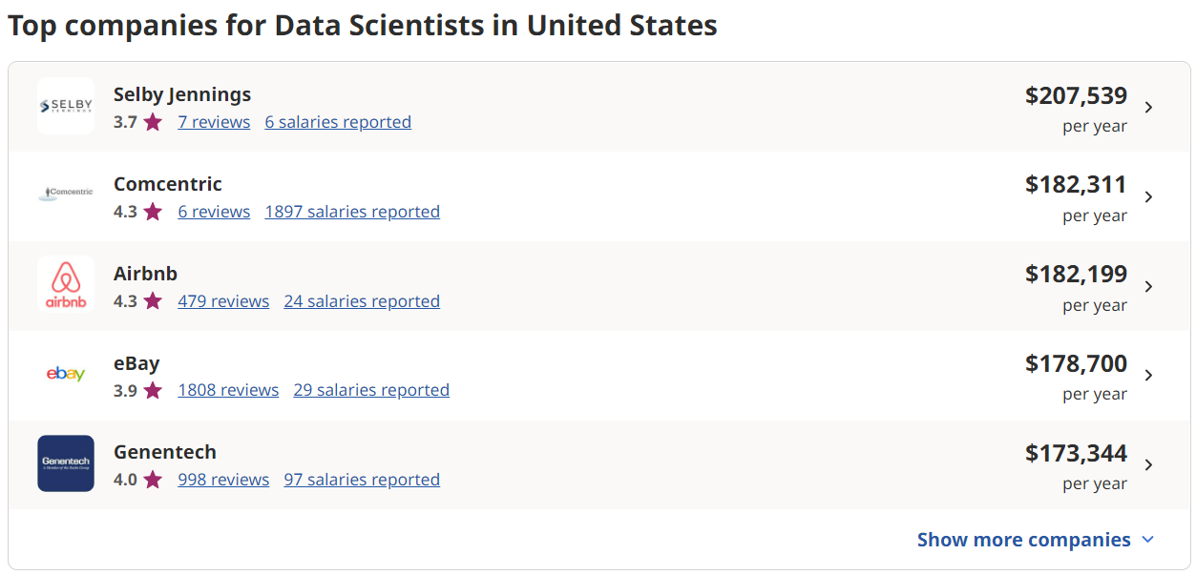
Pays Well
https://www.indeed.com/career/data-scientist/salaries

Slide 8
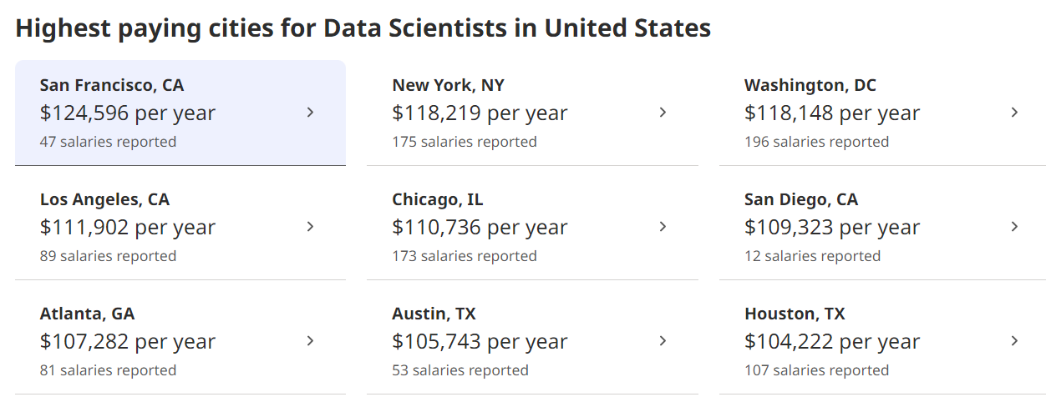
Pays Well
https://www.indeed.com/career/data-scientist/salaries

Slide 9
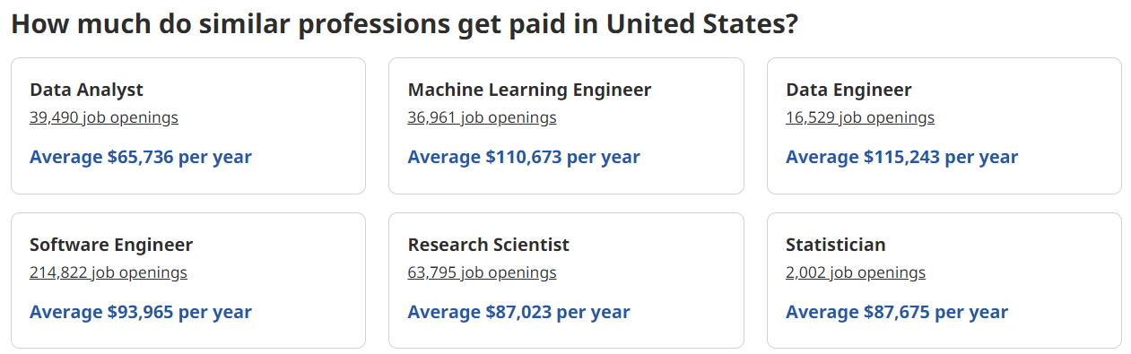
Pays Well
https://www.indeed.com/career/data-scientist/salaries

Slide 10
Where does data come from?

Slide 11







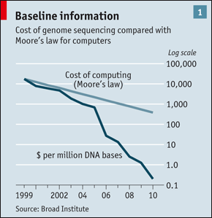
“Big Data” Sources
It’s All Happening On-line
User Generated (Web & Mobile)
Every:
Click
Ad impression
Billing event
Fast Forward, pause,…
Server request
Transaction
Network message
Fault
…
…..
Internet of Things / M2M
Health/Scientific Computing

Slide 12
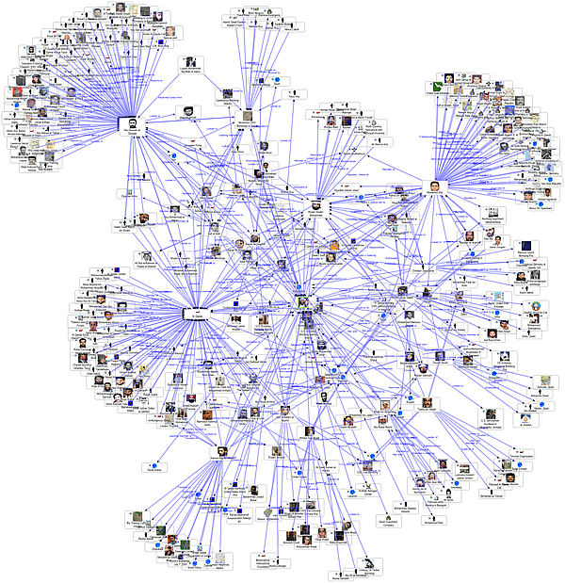
Graph Data
Lots of interesting data
has a graph structure:
Social networks
Communication networks
Computer Networks
Road networks
Citations
Collaborations/Relationships
…
Some of these graphs can get
quite large (e.g., Facebook*
user graph)

Slide 13
Data Science – A Definition
Data Science is the science which uses computer science, statistics and machine learning, visualization and human-computer interactions to collect, clean, integrate, analyze, visualize, interact with data to create data products.

Slide 14
Goal of Data Science
Turn data into data products.

Slide 15
How to use data?
Data => exploratory analysis => knowledge models => product / decision making
Data => predictive models => evaluate / interpret => product / decision making

Slide 16
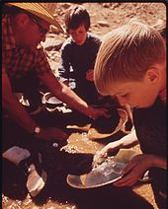
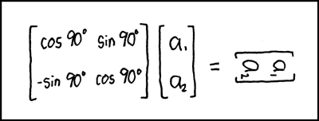
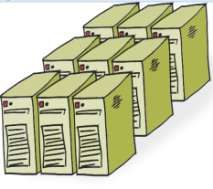
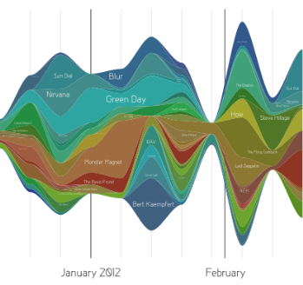
Data Scientist’s Practice
Clean,
prep
Hypothesize Model
Large Scale Exploitation
Digging Around in Data
Evaluate Interpret

Slide 17
Example data science applications
Marketing: predict the characteristics of high lifetime value (LTV) customers, which can be used to support customer segmentation, identify upsell opportunities…
Logistics: forecast how many of which things you need and where will we need them, which enables learn inventory and prevents out of stock situations
Healthcare: analyze survival statistics for different patient attributes (age, blood type, gender, etc.) and treatments; predict risk of re-admittance based on patient attributes, medical history, etc.

Slide 18
More Examples
Transaction Databases → Recommender systems (NetFlix), Fraud Detection (Security and Privacy)
Wireless Sensor Data → Smart Home, Real-time Monitoring, Internet of Things
Text Data, Social Media Data → Product Review and Consumer Satisfaction (Facebook, Twitter, LinkedIn), E-discovery
Software Log Data → Automatic Trouble Shooting (Splunk)
Genotype and Phenotype Data → Epic, 23andme, Patient-Centered Care, Personalized Medicine

Slide 19
About the course
A mixture of theory and practice
Introductory, broad overview of subjects
Focus on practical aspects
Language choice: python

Slide 20
Brief introduction of Python
Invented in the Netherlands, early 90s by Guido van Rossum
Open sourced from the beginning
Considered a scripting language, but is much more
No compilation needed
Scripts are evaluated by the interpreter, line by line
Functions need to be defined before they are called

Slide 21
Different ways to run python
Call python program via python interpreter from a Unix/windows command line
$ python testScript.py
Or make the script directly executable, with additional header lines in the script
Using python console
Typing in python statements. Limited functionality
>>> 3 +3
6
>>> exit()
Using ipython console
Typing in python statements. Very interactive.
In [167]: 3+3
Out [167]: 6
Typing in %run testScript.py
Many convenient “magic functions”

Slide 22
Anaconda, PyCharm for python3
PyCharm and Anaconda which include python environment and an IDE as well as many additional features
Most python modules needed in data processing are already installed with the anaconda distribution
Install with python 3.9

Slide 23
Python programming in <2 hours
This is not a comprehensive python language class
Will focus on parts of the language that is worth attention and useful in data processing
Comprehensive Python language reference and tutorial available in Anacondo Navigator under “Learning” and on python.org

Slide 24
Formatting
Many languages use curly braces to delimit blocks of code. Python uses indentation. Incorrect indentation causes error.
Comments start with #
Colons start a new block in many constructs, e.g. function definitions, if-then clause, for, while
for i in [1, 2, 3, 4, 5]:
# first line in "for i" block
print (i)
for j in [1, 2, 3, 4, 5]:
# first line in "for j" block
print (j)
# last line in "for j" block
print (i + j)
# last line in "for i" block print "done looping
print (i)
print ("done looping”)

Slide 25
Whitespace is ignored inside parentheses and brackets.
long_winded_computation = (1 + 2 + 3 + 4 + 5 + 6 + 7 + 8 + 9 + 10 + 11 + 12 + 13 + 14 +
15 + 16 + 17 + 18 + 19 + 20)
list_of_lists = [[1, 2, 3], [4, 5, 6], [7, 8, 9]]
easier_to_read_list_of_lists =
[ [1, 2, 3],
[4, 5, 6],
[7, 8, 9] ]
Alternatively:
long_winded_computation = 1 + 2 + 3 + 4 + 5 + 6 + 7 + 8 + \
9 + 10 + 11 + 12 + 13 + 14 + \
15 + 16 + 17 + 18 + 19 + 20

Slide 26
Modules
Certain features of Python are not loaded by default
In order to use these features, you’ll need to import the modules that contain them.
E.g.
import matplotlib.pyplot as plt
import numpy as np

Slide 27
Variables and objects
Variables are created the first time it is assigned a value
No need to declare type
Types are associated with objects not variables
X = 5
X = [1, 3, 5]
X = ‘python’
Assignment creates references, not copies
X = [1, 3, 5]
Y= X
X[0] = 2
Print (Y) # Y is [2, 3, 5]

Slide 28
Assignment
You can assign to multiple names at the same time
x, y = 2, 3
To swap values
x, y = y, x
Assignments can be chained
x = y = z = 3
Accessing a name before it’s been created (by assignment), raises an error

Slide 29
Arithmetic
a = 5 + 2 # a is 7
b = 9 – 3. # b is 6.0
c = 5 * 2 # c is 10
d = 5**2 # d is 25
e = 5 % 2 # e is 1
Built in numerical types: int, float, complex

Slide 30
f = 7 / 2
# in python 2, f will be 3, unless “from __future__ import division”
f = 7 / 2 # in python 3 f = 3.5
f = 7 // 2 # f = 3 in both python 2 and 3
f = 7 / 2. # f = 3.5 in both python 2 and 3
f = 7 / float(2) # f is 3.5 in both python 2 and 3
f = int(7 / 2) # f is 3 in both python 2 and 3

Slide 31
String - 1
Strings can be delimited by matching single or double quotation marks
single_quoted_string = 'data science'
double_quoted_string = "data science"
escaped_string = 'Isn\'t this fun'
another_string = "Isn't this fun"
real_long_string = 'this is a really long string. \
It has multiple parts, \
but all in one line.'
multi_line_string = """This is the first line.
and this is the second line
and this is the third line"""
Use triple quotes for multi line strings

Slide 32
String - 2
Use raw strings to output backslashes
tab_string = "\t" # represents the tab character
len(tab_string) # is 1
not_tab_string = r"\t" # represents the characters '\' and 't'
len(not_tab_string) # is 2
Strings can be concatenated (glued together) with the + operator, and repeated with *
s = 3 * 'un' + 'ium' # s is 'unununium'
Two or more string literals (i.e. the ones enclosed between quotes) next to each other are automatically concatenated
s1 = 'Py' 'thon'
s2 = s1 + '2.7'
real_long_string = ('this is a really long string. '
‘It has multiple parts, '
‘but all in one line.‘)

Slide 33
List - 1
integer_list = [1, 2, 3]
heterogeneous_list = ["string", 0.1, True]
list_of_lists = [ integer_list, heterogeneous_list, [] ]
list_length = len(integer_list) # equals 3
list_sum = sum(integer_list) # equals 6
Get the i-th element of a list
x = [i for i in range(10)] # is the list [0, 1, ..., 9]
zero = x[0] # equals 0, lists are 0-indexed
one = x[1] # equals 1
nine = x[-1] # equals 9, 'Pythonic' for last element
eight = x[-2] # equals 8, 'Pythonic' for next-to-last element
Get a slice of a list
one_to_four = x[1:5] # [1, 2, 3, 4]
first_three = x[:3] # [0, 1, 2]
last_three = x[-3:] # [7, 8, 9]
three_to_end = x[3:] # [3, 4, ..., 9]
without_first_and_last = x[1:-1] # [1, 2, ..., 8]
copy_of_x = x[:] # [0, 1, 2, ..., 9]
another_copy_of_x = x[:3] + x[3:] # [0, 1, 2, ..., 9]

Slide 34
List - 2
Check for memberships
1 in [1, 2, 3] # True
0 in [1, 2, 3] # False
Concatenate lists
x = [1, 2, 3]
y = [4, 5, 6]
x.extend(y) # x is now [1,2,3,4,5,6]
x = [1, 2, 3]
y = [4, 5, 6]
z = x + y # z is [1,2,3,4,5,6]; x is unchanged.
List unpacking (multiple assignment)
x, y = [1, 2] # x is 1 and y is 2
[x, y] = 1, 2 # same as above
x, y = 1, 2 # same as above
_, y = [1, 2] # y is 2, didn't care about the first element

Slide 35
List - 3
Modify content of list
x = [0, 1, 2, 3, 4, 5, 6, 7, 8]
x[2] = x[2] * 2 # x is [0, 1, 4, 3, 4, 5, 6, 7, 8]
x[-1] = 0 # x is [0, 1, 4, 3, 4, 5, 6, 7, 0]
x[3:5] = x[3:5] * 3 # x is [0, 1, 4, 9, 12, 5, 6, 7, 0]
x[5:6] = [] # x is [0, 1, 4, 9, 12, 7, 0]
del x[:2] # x is [4, 9, 12, 7, 0]
del x[:] # x is []
del x # referencing to x hereafter is a NameError
Strings can also be sliced. But they cannot be modified (they are immutable)
s = 'abcdefg'
a = s[0] # 'a'
x = s[:2] # 'ab'
y = s[-3:] # 'efg'
s[:2] = 'AB' # this will cause an error
s = 'AB' + s[2:] # str is now ABcdefg

Slide 36
The range() function
for i in range(5):
print (i) # will print 0, 1, 2, 3, 4 (in separate lines)
for i in range(2, 5):
print (i) # will print 2, 3, 4
for i in range(0, 10, 2):
print (i) # will print 0, 2, 4, 6, 8
for i in range(10, 2, -2):
print (i) # will print 10, 8, 6, 4
>>> a = ['Mary', 'had', 'a', 'little', 'lamb']
>>> for i in range(len(a)):
... print(i, a[i])
...
0 Mary
1 had
2 a
3 little
4 lamb

Slide 37
Range() in python 2 and 3
In python 2, range(5) is equivalent to [0, 1, 2, 3, 4]
In python 3, range(5) is an object which can be iterated, but not identical to [0, 1, 2, 3, 4] (lazy iterator)
print (range(3)) # in python 3, will see "range(0, 3)"
print (range(3)) # in python 2, will see "[0, 1, 2]"
print (list(range(3))) # will print [0, 1, 2] in python 3
x = range(5)
print (x[2]) # in python 2, will print "2"
print (x[2]) # in python 3, will also print “2”
x[2] = 5 # in python 2, will result in [0, 1, 5, 3, 4, 5]
x[2] = 5 # in python 3, will cause an error.

Slide 38
Ref to lists
What are the expected output for the following code?
a = list(range(10))
b = a
b[0] = 100
print(a)
a = list(range(10))
b = a[:]
b[0] = 100
print(a)
[100, 1, 2, 3, 4, 5, 6, 7, 8, 9]
[0, 1, 2, 3, 4, 5, 6, 7, 8, 9]

Slide 39
tuples
Note: tuple is defined by comma, not parens, which is only used for convenience. So a = (1) is not a tuple, but a = (1,) is.
Similar to lists, but are immutable
a_tuple = (0, 1, 2, 3, 4)
Other_tuple = 3, 4
Another_tuple = tuple([0, 1, 2, 3, 4])
Hetergeneous_tuple = (‘john’, 1.1, [1, 2])
Can be sliced, concatenated, or repeated
a_tuple[2:4] # will print (2, 3)
Cannot be modified
a_tuple[2] = 5
TypeError: 'tuple' object does not support item assignment

Slide 40
Tuples - 2
Useful for returning multiple values from functions
Tuples and lists can also be used for multiple assignments
def sum_and_product(x, y):
return (x + y),(x * y)
sp = sum_and_product(2, 3) # equals (5, 6)
s, p = sum_and_product(5, 10) # s is 15, p is 50
x, y = 1, 2
[x, y] = [1, 2]
(x, y) = (1, 2)
x, y = y, x

Slide 41
Dictionaries
A dictionary associates values with unique keys
empty_dict = {} # Pythonic
empty_dict2 = dict() # less Pythonic
grades = { "Joel" : 80, "Tim" : 95 } # dictionary literal
Access/modify value with key
joels_grade = grades["Joel"] # equals 80
grades["Tim"] = 99 # replaces the old value
grades["Kate"] = 100 # adds a third entry
num_students = len(grades) # equals 3
try:
kates_grade = grades["Kate"]
except KeyError:
print "no grade for Kate!"

Slide 42
Dictionaries - 2
Check for existence of key
joel_has_grade = "Joel" in grades # True
kate_has_grade = "Kate" in grades # False
Use “get” to avoid keyError and add default value
joels_grade = grades.get("Joel", 0) # equals 80
kates_grade = grades.get("Kate", 0) # equals 0
no_ones_grade = grades.get("No One") # default default is None
#Which of the following is faster?
'Joel' in grades
'Joel' in all_keys
#Which of the following is faster?
'Joel' in grades # faster. Hashtable
'Joel' in all_keys # slower. List.
Get all items
all_keys = grades.keys() # return a list of all keys
all_values = grades.values() # return a list of all values
all_pairs = grades.items() # a list of (key, value) tuples

Slide 43
Dictionaries - 2
Check for existence of key
joel_has_grade = "Joel" in grades # True
kate_has_grade = "Kate" in grades # False
Use “get” to avoid keyError and add default value
joels_grade = grades.get("Joel", 0) # equals 80
kates_grade = grades.get("Kate", 0) # equals 0
no_ones_grade = grades.get("No One") # default default is None
Get all items
In python3, The following will not return lists but iterable objects
all_keys = grades.keys() # return a list of all keys
all_values = grades.values() # return a list of all values
all_pairs = grades.items() # a list of (key, value) tuples

Slide 44
Difference between python 2 and python 3: Iterable objects vs lists
In Python 3, range() returns a lazy iterable object.
Value created when needed
Can be accessed by index
Similarly, dict.keys(), dict.values(), and dict.items() (also map, filter, zip, see next)
Value can NOT be accessed by index
Can convert to list if really needed
Can use for loop to iterate
x = range(10000000) #fast
x[10000] #allowed. fast
keys = grades.keys()
keys[0] # error
for key in keys: print (key) #ok

Slide 45
Control flow - 1
if-else
if 1 > 2:
message = "if only 1 were greater than two..."
elif 1 > 3:
message = "elif stands for 'else if'"
else:
message = "when all else fails use else (if you want to)"
print (message)
parity = "even" if x % 2 == 0 else "odd"
Difference between python 2 and python3 print
In python 2, print is a statement
Print(message) and print message are both valid
In python 3, print is a function
Only print(message) is valid

Slide 46
Truthiness
All keywords are case sensitive.
0, 0.0, [], (), ‘’, None are considered False. Most other values are True.
True
False
None
and
or
not
any
all
In [137]: print ("True") if '' else print ('False')
False
a = [0, 0, 0, 1]
any(a)
Out[135]: True
all(a)
Out[136]: False

Slide 47
Comparison
Operation | Meaning
< | strictly less than
<= | less than or equal
> | strictly greater than
>= | greater than or equal
== | equal
!= | not equal
is | object identity
is not | negated object identity
a = [0, 1, 2, 3, 4]
b = a
c = a[:]
a == b
Out[129]: True
a is b
Out[130]: True
a == c
Out[132]: True
a is c
Out[133]: False
Bitwise operators: & (AND), | (OR), ^ (XOR), ~(NOT), << (Left Shift), >> (Right Shift)

Slide 48
Control flow - 2
loops
x = 0
while x < 10:
print (x, "is less than 10“)
x += 1
What happens if we forgot to indent?
for x in range(10):
pass
Keyword pass in loops:
Does nothing, empty statement placeholder for future code.
for x in range(10):
if x == 3:
continue # go immediately to the next iteration
if x == 5:
break # quit the loop entirely
print (x)

Slide 49
Exceptions
try:
print 0 / 0
except ZeroDivisionError:
print ("cannot divide by zero")
https://docs.python.org/3/tutorial/errors.html

Slide 50
Functions - 1
Functions are defined using def
def double(x):
"""this is where you put an optional docstring
that explains what the function does.
for example, this function multiplies its input by 2"""
return x * 2
You can call a function after it is defined
z = double(10) # z is 20
You can give default values to parameters
def my_print(message="my default message"):
print (message)
my_print("hello") # prints 'hello'
my_print() # prints 'my default message‘

Slide 51
Functions - 2
Sometimes it is useful to specify arguments by name
def subtract(a=0, b=0):
return a – b
subtract(10, 5) # returns 5
subtract(0, 5) # returns -5
subtract(b = 5) # same as above
subtract(b = 5, a = 0) # same as above

Slide 52
Functions - 3
Functions are objects too
In [12]: def double(x): return x * 2
...: DD = double;
...: DD(2)
...:
Out[12]: 4
In [16]: def apply_to_one(f):
...: return f(1)
...: x=apply_to_one(DD)
...: x
...:
Out[16]: 2

Slide 53
Functions – lambda expression
Small anonymous functions can be created with the lambda keyword.
In [18]: y=apply_to_one(lambda x: x+4)
In [19]: y
Out[19]: 5
In [104]: def small_func(x): return x+4
...: apply_to_one(small_func)
Out[104]: 5

Slide 54
lambda expression - 2
Small anonymous functions can be created with the lambda keyword.
In [22]: pairs = [(2, 'two'), (3, 'three'), (1, 'one'), (4, 'four')]
...: pairs.sort(key=lambda pair: pair[0])
...: pairs
Out[22]: [(1, 'one'), (2, 'two'), (3, 'three'), (4, 'four')]
In [107]: def getKey(pair): return pair[0]
...: pairs.sort(key=getKey)
...: pairs
Out[107]: [(1, 'one'), (2, 'two'), (3, 'three'), (4, 'four')

Slide 55
Sorting list
Sorted(list): keeps the original list intact and returns a new sorted list
list.sort: sort the original list
Change the default behavior of sorted
x = [4,1,2,3]
y = sorted(x) # is [1,2,3,4], x is unchanged
x.sort() # now x is [1,2,3,4]
# sort the list by absolute value from largest to smallest
x = [-4,1,-2,3]
y = sorted(x, key=abs, reverse=True) # is [-4,3,-2,1]
# sort the grades from highest count to lowest
# using an anonymous function
newgrades = sorted(grades.items(),
key=lambda (name, grade): grade,
reverse=True)

Slide 56
List comprehension
A very convenient way to create a new list
In [51]: squares = [x * x for x in range(5)]
In [52]: squares
Out[52]: [0, 1, 4, 9, 16]
In [64]: for x in range(5): squares[x] = x * x
...: squares
Out[64]: [0, 1, 4, 9, 16]

Slide 57
List comprehension - 2
Can also be used to filter list
In [65]: even_numbers = [x for x in range(5) if x % 2 == 0]
In [66]: even_numbers
Out[66]: [0, 2, 4]
In [68]: even_numbers = []
In [69]: for x in range(5):
...: if x % 2 == 0:
...: even_numbers.append(x)
...: even_numbers
Out[69]: [0, 2, 4]

Slide 58
List comprehension - 3
More complex examples:
# create 100 pairs (0,0) (0,1) ... (9,8), (9,9)
pairs = [(x, y)
for x in range(10)
for y in range(10)]
# only pairs with x < y,
# range(lo, hi) equals
# [lo, lo + 1, ..., hi - 1]
increasing_pairs = [(x, y)
for x in range(10)
for y in range(x + 1, 10)]

Slide 59
Functools: map, reduce, filter
Do not confuse with MapReduce in big data
Convenient tools in python to apply function to sequences of data
In [203]: def double(x): return 2*x
...: b=range(5)
...: list(map(double, b))
Out[203]: [0, 2, 4, 6, 8]
In [205]: [double(i) for i in range(5)]
Out[205]: [0, 2, 4, 6, 8]
In [204]: double(b)
Traceback (most recent call last):
…
TypeError: unsupported operand type(s) for *: 'int' and 'range'

Slide 60
Functools: map, reduce, filter
Do not confuse with MapReduce in big data
Convenient tools in python to apply function to sequences of data
In [208]: def is_even(x): return x%2==0
...: a=[0, 1, 2, 3]
...: list(filter(is_even, a))
...:
Out[208]: [0, 2]
In [209]: [a[i] for i in a if is_even(i)]
Out[209]: [0, 2]

Slide 61
Functools: map, reduce, filter
Do not confuse with MapReduce in big data
Convenient tools in python to apply function to sequences of data
In [216]: from functools import reduce
In [217]: reduce(lambda x, y: x+y, range(10))
Out[217]: 45
In [220]: reduce(lambda x, y: x*y, [1, 2, 3, 4])
Out[220]: 24
Working :
At first step, first two elements of sequence are picked and the result is obtained.
Next step is to apply the same function to the previously attained result and the number just succeeding the second element and the result is again stored.
This process continues till no more elements are left in the container.
The final returned result is returned and printed on console.

Slide 62
zip
Useful to combined multiple lists into a list of tuples
In [238]: list(zip(['a', 'b', 'c'], [1, 2, 3], ['A', 'B', 'C']))
Out[238]: [('a', 1, 'A'), ('b', 2, 'B'), ('c', 3, 'C')]
In [245]: names = ['James', 'Tom', 'Mary']
...: grades = [100, 90, 95]
...: list(zip(names, grades))
...:
Out[245]: [('James', 100), ('Tom', 90), ('Mary', 95)]

Slide 63
Argument unpacking
zip(*[a, b,c]) same as zip(a, b, c)
In [252]: gradeBook = [['James', 100],
['Tom', 90],
['Mary', 95]]
...: [names, grades]=zip(*gradeBook)
In [253]: names
Out[253]: ('James', 'Tom', 'Mary')
In [254]: grades
Out[254]: (100, 90, 95)
In [259]: list(zip(['James', 100], ['Tom', 90], ['Mary', 95]))
Out[259]: [('James', 'Tom', 'Mary'), (100, 90, 95)]

Slide 64
args and kargs
Convenient for taking variable number of unnamed and named parameters
In [260]: def magic(*args, **kwargs):
...: print ("unnamed args:", args)
...: print ("keyword args:", kwargs)
...: magic(1, 2, key="word", key2="word2")
...:
unnamed args: (1, 2)
keyword args: {'key': 'word', 'key2': 'word2'}

Slide 65
Useful methods and modules
The Python Tutorial
Input and Output
The Python Standard Library Reference
Common string methods
Regular expression operations
Numeric and Mathematical Modules
CSV File Reading and Writing

Slide 66
Files - input
inflobj = open(‘data’, ‘r’) | Open the file ‘data’ for input
S = inflobj.read() | Read whole file into one String
S = inflobj.read(N) | Reads N bytes (N >= 1)
L = inflobj.readline () | Read one line
L = inflobj.readlines() | Returns a list of line strings
https://docs.python.org/3/tutorial/inputoutput.html

Slide 67
Files - output
outflobj = open(‘data’, ‘w’) | Open the file ‘data’ for writing
outflobj.write(S) | Writes the string S to file
outflobj.writelines(L) | Writes each of the strings in list L to file
outflobj.close() | Closes the file
https://docs.python.org/3/tutorial/inputoutput.html

Slide 68
Module math
Command name | Description
abs(value) | absolute value
ceil(value) | rounds up
cos(value) | cosine, in radians
floor(value) | rounds down
log(value) | logarithm, base e
log10(value) | logarithm, base 10
max(value1, value2) | larger of two values
min(value1, value2) | smaller of two values
round(value) | nearest whole number
sin(value) | sine, in radians
sqrt(value) | square root
Constant | Description
e | 2.7182818...
pi | 3.1415926...
# preferred.
import math
math.abs(-0.5)
#bad style. Many unknown #names in name space.
from math import *
abs(-0.5)
#This is fine
from math import abs
abs(-0.5)

Slide 69
Module random
Generating random numbers are important in statistics
In [75]: import random
...: four_uniform_randoms = [random.random() for _ in range(4)]
...: four_uniform_randoms
...:
Out[75]:
[0.5687302894847388,
0.6562738117250464,
0.3396960191199996,
0.016968446644451407]
Other useful functions: seed(), randint, randrange, shuffle, etc.
Type in “random” and then use tab completion to see available functions and use “?” to see docstring of function.

Slide 70
Important python modules for data science
Numpy
Key module for scientific computing
Convenient and efficient ways to handle multi dimensional arrays
pandas
DataFrame
Flexible data structure of labeled tabular data
Matplotlib: for plotting
Scipy: solutions to common scientific computing problem such as linear algebra, optimization, statistics, sparse matrix

Slide 71
Module paths
In order to be able to find a module called myscripts.py, the interpreter scans the list sys.path of directory names.
The module must be in one of those directories.
>>> import sys
>>> sys.path
['C:\\Python26\\Lib\\idlelib', 'C:\\WINDOWS\\system32\\python26.zip', 'C:\\Python26\\DLLs', 'C:\\Python26\\lib', 'C:\\Python26\\lib\\plat-win', 'C:\\Python26\\lib\\lib-tk', 'C:\\Python26', 'C:\\Python26\\lib\\site-packages']
>>> import myscripts
Traceback (most recent call last):
File "<pyshell#2>", line 1, in <module>
import myscripts.py
ImportError: No module named myscripts.py

Slide 72
Appendix Sequence types: Tuples, Lists, and Strings

Slide 73
Sequence Types
Tuple: (‘john’, 32, [CMSC])
A simple immutable ordered sequence of items
Items can be of mixed types, including collection types
Strings: “John Smith”
Immutable
Conceptually very much like a tuple
List: [1, 2, ‘john’, (‘up’, ‘down’)]
Mutable ordered sequence of items of mixed types

Slide 74
Similar Syntax
All three sequence types (tuples, strings, and lists) share much of the same syntax and functionality.
Key difference:
Tuples and strings are immutable
Lists are mutable
The operations shown in this section can be applied to all sequence types
most examples will just show the operation performed on one

Slide 75
Defining Sequence
Define tuples using parentheses and commas
>>> tu = (23, ‘abc’, 4.56, (2,3), ‘def’)
Define lists are using square brackets and commas
>>> li = [“abc”, 34, 4.34, 23]
Define strings using quotes (“, ‘, or “““).
>>> st = “Hello World”
>>> st = ‘Hello World’
>>> st = “““This is a multi-line
string that uses triple quotes.”””

Slide 76
Accessing one element
Access individual members of a tuple, list, or string using square bracket “array” notation
Note that all are 0 based…
>>> tu = (23, ‘abc’, 4.56, (2,3), ‘def’)
>>> tu[1] # Second item in the tuple.
‘abc’
>>> li = [“abc”, 34, 4.34, 23]
>>> li[1] # Second item in the list.
34
>>> st = “Hello World”
>>> st[1] # 2nd character in string. Still str type
‘e’

Slide 77
Positive and negative indices
>>> t = (23, ‘abc’, 4.56, (2,3), ‘def’)
Positive index: count from the left, starting with 0
>>> t[1]
‘abc’
Negative index: count from right, starting with –1
>>> t[-3]
4.56

Slide 78
Slicing: return copy of a subset
>>> t = (23, ‘abc’, 4.56, (2,3), ‘def’)
Return a copy of the container with a subset of the original members. Start copying at the first index, and stop copying before second.
>>> t[1:4]
(‘abc’, 4.56, (2,3))
Negative indices count from end
>>> t[1:-1]
(‘abc’, 4.56, (2,3))

Slide 79
Slicing: return copy of a subset
>>> t = (23, ‘abc’, 4.56, (2,3), ‘def’)
Omit first index to make copy starting from beginning of the container
>>> t[:2]
(23, ‘abc’)
Omit second index to make copy starting at first index and going to end
>>> t[2:]
(4.56, (2,3), ‘def’)

Slide 80
Copying the Whole Sequence
[ : ] makes a copy of an entire sequence
>>> t[:]
(23, ‘abc’, 4.56, (2,3), ‘def’)
Note the difference between these two lines for mutable sequences
>>> l2 = l1 # Both refer to 1 ref,
# changing one affects both
>>> l2 = l1[:] # Independent copies, two refs

Slide 81
The ‘in’ Operator
Boolean test whether a value is inside a container:
>>> t = [1, 2, 4, 5]
>>> 3 in t
False
>>> 4 in t
True
>>> 4 not in t
False
For strings, tests for substrings
>>> a = 'abcde'
>>> 'c' in a
True
>>> 'cd' in a
True
>>> 'ac' in a
False

Slide 82
The + Operator
The + operator produces a new tuple, list, or string whose value is the concatenation of its arguments.
>>> (1, 2, 3) + (4, 5, 6)
(1, 2, 3, 4, 5, 6)
>>> [1, 2, 3] + [4, 5, 6]
[1, 2, 3, 4, 5, 6]
>>> “Hello” + “ ” + “World”
‘Hello World’

Slide 83
The * Operator
The * operator produces a new tuple, list, or string that “repeats” the original content.
>>> (1, 2, 3) * 3
(1, 2, 3, 1, 2, 3, 1, 2, 3)
>>> [1, 2, 3] * 3
[1, 2, 3, 1, 2, 3, 1, 2, 3]
>>> “Hello” * 3
‘HelloHelloHello’

Slide 84
Mutability: Tuples vs. Lists

Slide 85
Lists are mutable
>>> li = [‘abc’, 23, 4.34, 23]
>>> li[1] = 45
>>> li [‘abc’, 45, 4.34, 23]
We can change lists in place.
Name li still points to the same memory reference when we’re done.

Slide 86
Tuples are immutable
>>> t = (23, ‘abc’, 4.56, (2,3), ‘def’)
>>> t[2] = 3.14
Traceback (most recent call last):
File "<pyshell#75>", line 1, in -toplevel-
tu[2] = 3.14
TypeError: object doesn't support item assignment
You can’t change a tuple.
You can make a fresh tuple and assign its reference to a previously used name.
>>> t = (23, ‘abc’, 3.14, (2,3), ‘def’)
The immutability of tuples means they’re faster than lists.

Slide 87
Operations on Lists Only
>>> li = [1, 11, 3, 4, 5]
>>> li.append(‘a’) # Note the method syntax
>>> li
[1, 11, 3, 4, 5, ‘a’]
>>> li.insert(2, ‘i’)
>>>li
[1, 11, ‘i’, 3, 4, 5, ‘a’]

Slide 88
The extend method vs +
+ creates a fresh list with a new memory ref
extend operates on list li in place.
>>> li.extend([9, 8, 7])
>>> li
[1, 2, ‘i’, 3, 4, 5, ‘a’, 9, 8, 7]
Potentially confusing:
extend takes a list as an argument.
append takes a singleton as an argument.
>>> li.append([10, 11, 12])
>>> li
[1, 2, ‘i’, 3, 4, 5, ‘a’, 9, 8, 7, [10, 11, 12]]

Slide 89
Operations on Lists Only
Lists have many methods, including index, count, remove, reverse, sort
>>> li = [‘a’, ‘b’, ‘c’, ‘b’]
>>> li.index(‘b’) # index of 1st occurrence
1
>>> li.count(‘b’) # number of occurrences
2
>>> li.remove(‘b’) # remove 1st occurrence
>>> li
[‘a’, ‘c’, ‘b’]

Slide 90
Operations on Lists Only
>>> li = [5, 2, 6, 8]
>>> li.reverse() # reverse the list *in place*
>>> li
[8, 6, 2, 5]
>>> li.sort() # sort the list *in place*
>>> li
[2, 5, 6, 8]
>>> li.sort(some_function)
# sort in place using user-defined comparison

Slide 91
Tuple details
The comma is the tuple creation operator, not parens
>>> 1,
(1,)
Python shows parens for clarity (best practice)
>>> (1,)
(1,)
Don't forget the comma!
>>> (1)
1
Trailing comma only required for singletons others
Empty tuples have a special syntactic form
>>> ()
()
>>> tuple()
()

Slide 92
Summary: Tuples vs. Lists
Lists slower but more powerful than tuples
Lists can be modified, and they have lots of handy operations and methods
Tuples are immutable and have fewer features
To convert between tuples and lists use the list() and tuple() functions:
li = list(tu)
tu = tuple(li)

Slide 93
References
[1] MCKINNEY, Python for Data Analysis: Data Wrangling with Pandas, NumPy, and IPython, O'Reilly Media, 2018.
[2] GRUS, Data Science from Scratch: First Principles with Python, O'Reilly Media, 2019.
[3] VANDERPLAS, Python Data Science Handbook: Essential Tools for Working with Data, O'Reilly Media, 2016.
[4] DOWNEY, Think Stats: Exploratory Data Analysis in Python, Green Tea Press, 2014.
[5] Data Science course, Dr. Jianhua Ruan, The University of Texas at San Antonio (https://cs.utsa.edu)

Slide 94
Thank you for listening!

